Slide 1
Introduction to Phishing Architecture
Utilizing GoPhish to Create an Automated Phishing Framework
Created By Jack Kelly

Slide 2

Agenda
Sign in
Announcements
Sign in (with phrase of the day)
What is Phishing?
Why Phishing Simulations?
What is Gophish?
What is MailHog?
Architecture Overview
GoPhish Feature Exploration
GoPhish/Mailhog Docker Setup
Creating a Phishing Campaign
Egressing Phished Credentials
Phrase of the day is “Gone Phishin”

Slide 3

What is Phishing?
Phishing is a social engineering attack where an attacker impersonates a trusted entity to steal information.
Common phishing techniques:
  Email phishing (fake login pages, attachments)
  Spear phishing (targeted attacks)
  Smishing (SMS-based phishing)
  Vishing (voice phishing)

Slide 4
Why Phishing Simulations?
Educate users on recognizing phishing attempts.
Assess security awareness within an organization.
Improve response times and incident handling.
Notes:
Need to add notes to these slides

Slide 5

What is Gophish?
Open-source phishing framework for testing awareness.
Features:
  Create email phishing campaigns
  Track email opens, link clicks, credentials submitted
  Generate custom landing pages
  Lightweight and easy to deploy with Docker.

Slide 6

What is MailHog?
MailHog is an email testing tool that:
  Acts as a local SMTP server
  Captures emails sent by Gophish
  Provides a web interface for viewing emails
Useful for safe phishing simulations without sending real emails.

Slide 7
Architecture Overview
Components:
Gophish (Phishing platform)
MailHog (SMTP server for email testing)
Docker (for containerized setup)
Workflow:
Gophish sends phishing emails via MailHog.
MailHog captures and displays emails.
Victims interact with the phishing landing page.
Gophish logs user actions.

Slide 8
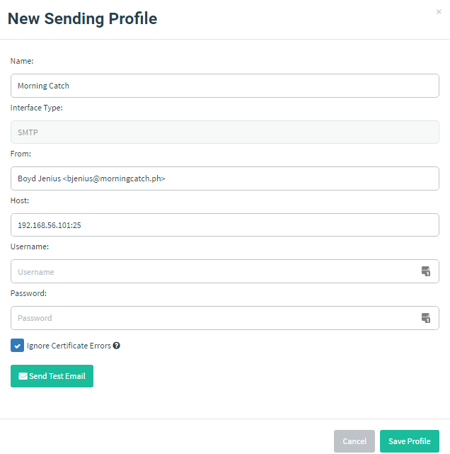
GoPhish Features: Sender Profiles
Key Components:
  SMTP server settings
  Sender name & email
  Authentication credentials
  Ability to bypass spam filters
Importance:
  Ensures emails are sent realistically without triggering security filters
Notes:
Configurations for sending phishing emails

Slide 9
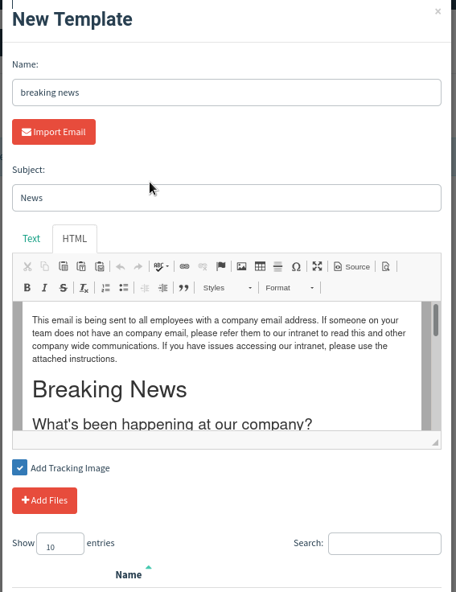
GoPhish Features: Email Templates
Key Components:
  Ability to import existing emails as HTML
  Ability to insert variables (e.g., user name, email)
  Inclusion of malicious links or attachments for testing
  Can mimic real corporate communication styles
Importance:
  Helps create realistic phishing scenarios for effective training
Notes:
Predefined phishing email formats

Slide 10
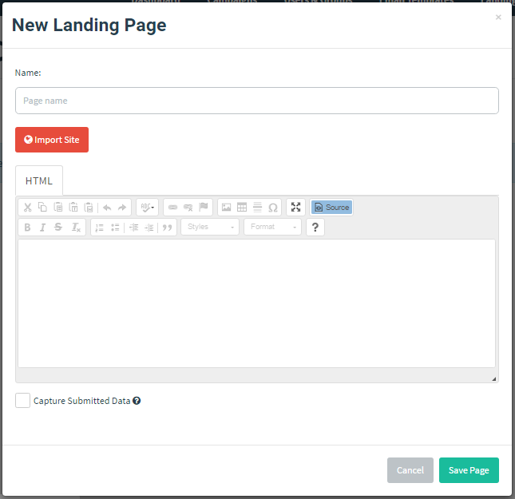
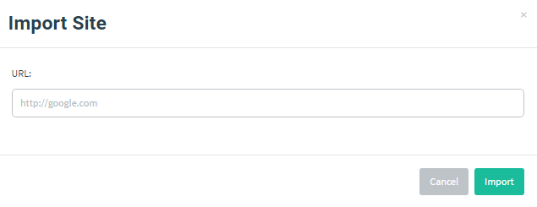
GoPhish Features: Landing Pages
Key Components:
  Easily copy existing HTML pages by URL
  Forms to collect user input
  Can mimic real-world login portals
  Tracking for interactions (e.g., clicks, form submissions)
  Automatically redirect victim to real site upon form submission.
Notes:
Fake web pages designed to capture credentials

Slide 11
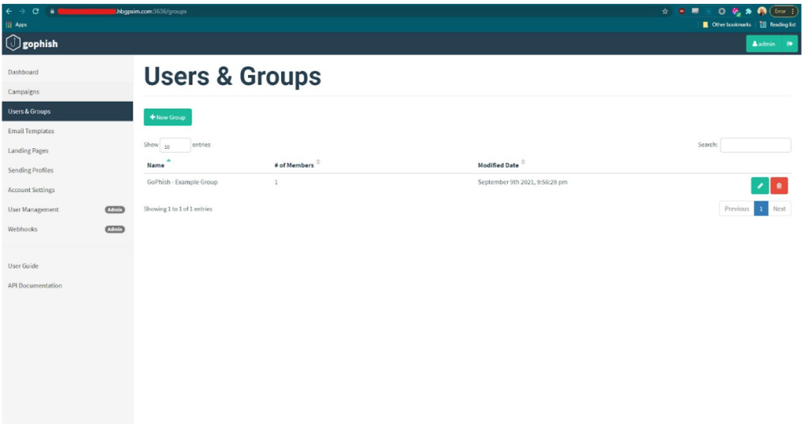
GoPhish Features: Users & Groups
Key Components:
  Import users via CSV
  Organize users into groups
  Customize phishing scenarios
per group
  Track individual responses
Importance:
  Allows tailored phishing simulations per department/team
Notes:
Target audience for phishing campaigns

Slide 12
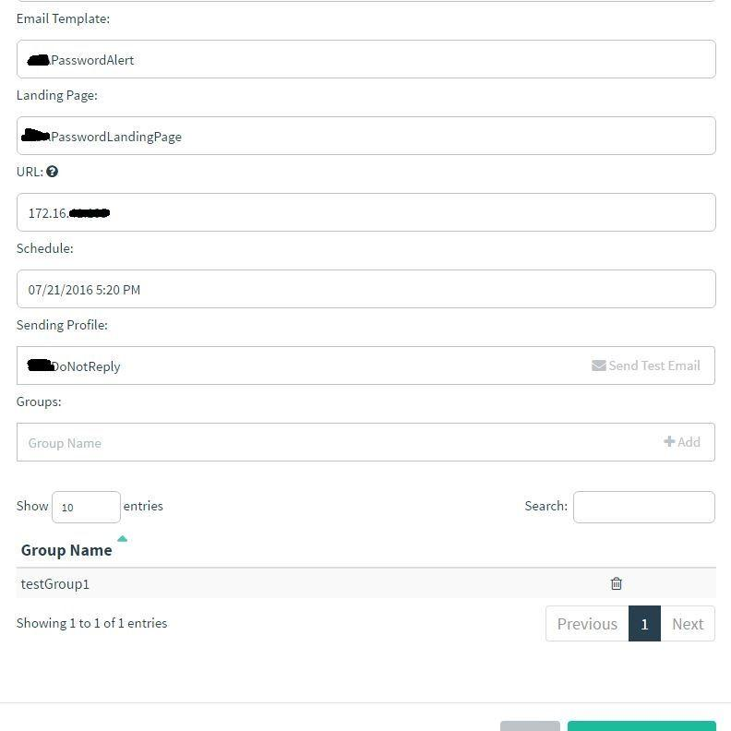
GoPhish Features: Campaigns
Key Components:
  Email template selection
  Targeted user groups
  Scheduling and automation
  Real-time tracking (email opens, clicks, credentials entered)
Importance:
  Provides actionable insights into organizational phishing risks
Notes:
End-to-end phishing attack simulation

Slide 13
Pause
Questions?
Next: GoPhish Demo

Slide 14
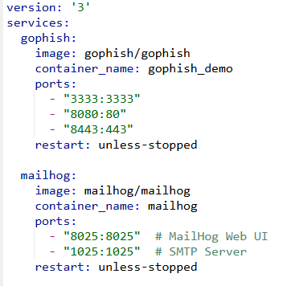
Installing Gophish & MailHog with Docker
Use docker compose to create a container with GoPhish and MailHog pre-configured.
In the same directory as your docker-compose.yaml file, run the following command:
$ docker-compose up -d
docker-compose.yaml

Slide 15
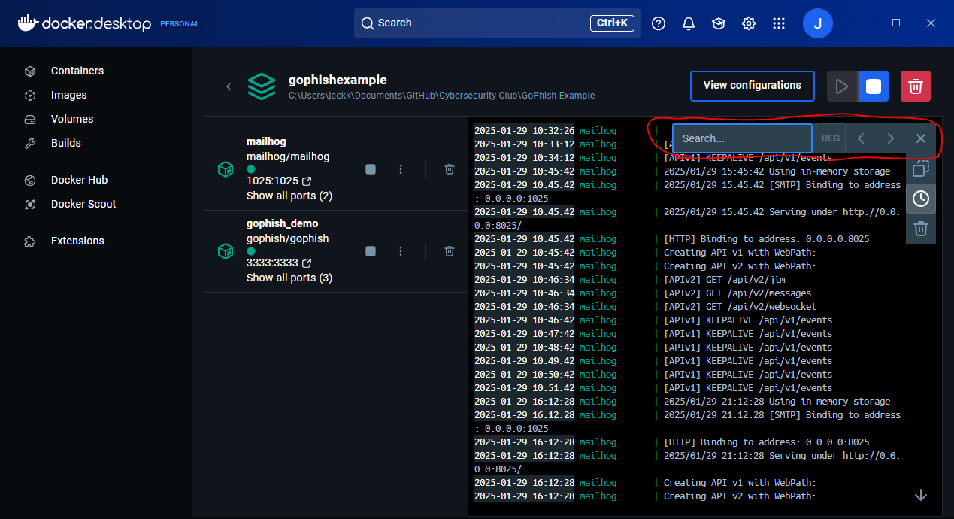
Finding GoPhish Default Credentials
GoPhish will create a randomly generated password for the ‘admin’ user to use for the first login. To find this password, search the docker logs via this command:
$ docker logs {container name} | grep "User: admin"
If using docker desktop, you can alternatively search the logs via the app:

Slide 16

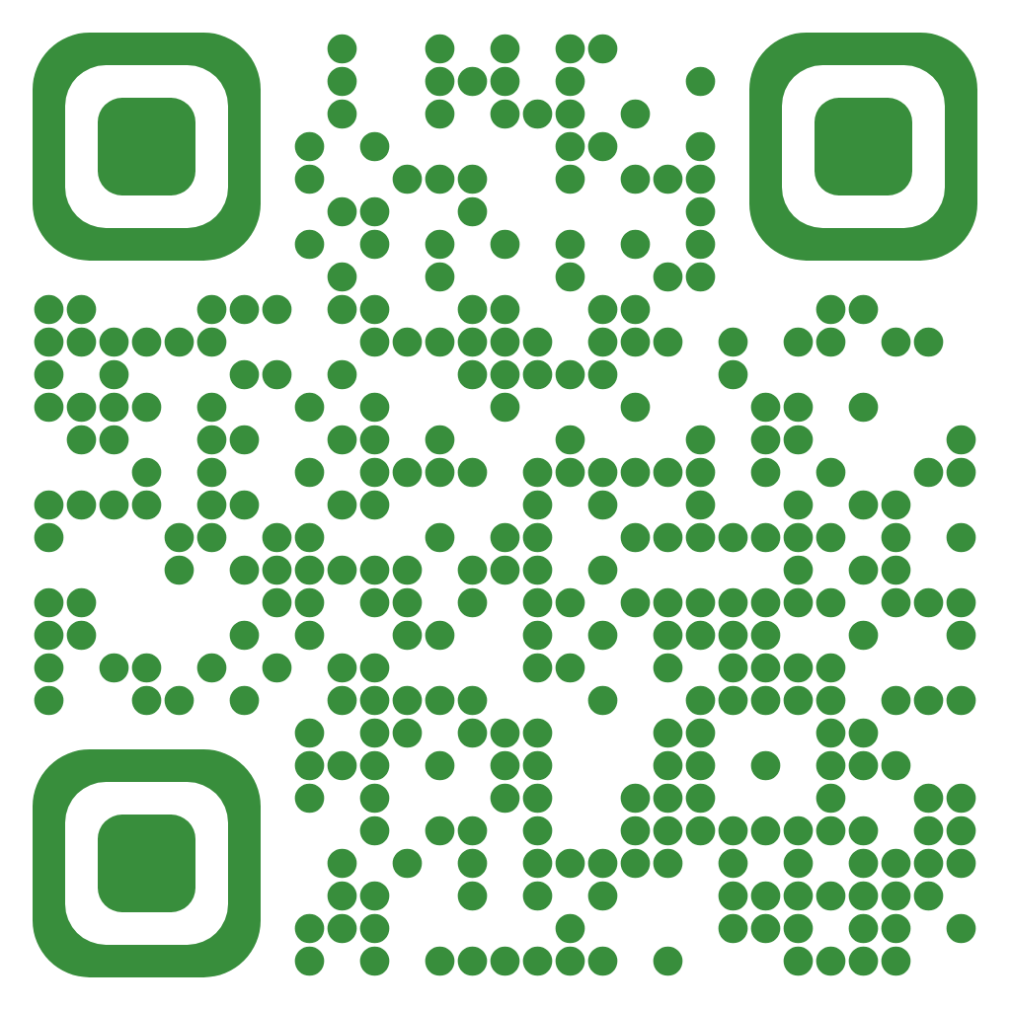

Thank You!
Jack Kelly
Vice President
B.S. Computer Science | May 2024
M.S. Secure Computing | May 2025
GitHub - JKelly423
ResearchGate
LinkedIn - JKelly423

